Slide 1

Personal AI Assistant
Installation
A hands-on hour. Open your laptop: you are building your own AI Second Brain with me, not watching me build one.
MeshPro × Expectus
Notes:
Leave this up only briefly — the checklist is the slide you actually want on screen while people settle. Say the rule in the first ten seconds: laptops open, we build together, nobody watches.

Slide 2

WHILE EVERYONE GETS READY
Before we start
Four things. Three of them you already have.
—
Claude, on your laptop
The desktop app, signed in. This is where every step happens.
—
Obsidian
Free, five minutes to install. It is how you read and edit your vault — and creating the vault makes the folder for you.
—
Somewhere to keep it
C:\AI is a good home. Nothing to create yet; step one does it.
—
Nothing else
No Python, no terminal, no account to create, no plugin to buy.
02
Notes:
Put this up as people walk in and leave it up. Walk the room while they install Obsidian — a laptop stalled at step one stays stalled all hour.

Slide 3

THE POINT OF THE HOUR
What you will have when you leave
Not a demo you watched — an architecture on your own laptop, and enough of a grip on it to keep building after today.
Your work has a place to live
An organisation that works for you
A way to keep building
Agents, skills, workflows, projects, schedules. You will have made one of each by the end, so the next one is just more of the same.
Accounts, promises, half-finished drafts — written once, in plain text you own, instead of re-typed into a chat window every morning.
Departments for the parts of your job, an executive answering for each, specialists under them, and skills that hold your method.
Everything you build today is yours, on your own machine, and none of it needs us afterwards.
03
Notes:
This is the goal slide. Say the third card out loud twice — they are not here to receive a setup, they are here to learn how to extend one. Everything after this is that promise being kept.

Slide 4
THE IDEA
This is not being built for you.
It is being built for the agents.
Your vault is not a nicer set of notes. It is a structure an LLM can read, navigate and act on — written in the shape a machine needs, which happens to also be readable by a person.
ONE HOME
FIELDS, NOT PROSE
THE GRAPH
A fact lives in one place
Every note is labelled
Linked, never copied
So an agent never has to choose between two versions of the truth — and neither do you.
Plain-text fields it can filter, count and reason over, instead of guessing from prose.
The graph is how it finds context. Copy-paste breaks it; a link makes it navigable.
04
Notes:
The line that separates this from note-taking advice. Say it plainly: we are writing for the agents. A human-friendly vault is a side effect of a machine-readable one, not the goal.

Slide 5
THE ONE TOOL WORTH HAVING
Obsidian: your vault, and why it is worth five minutes
Obsidian does not store anything. It reads a folder — and when you create a vault, it makes that folder for you.
WHAT IT GIVES THE AGENTS
IF YOU SKIP IT TODAY
Retrieval that actually works
Everything still works
Backlinks and the graph turn your notes into something an agent can walk: from a client, to the promise, to the workflow that delivers it.
Plus the plugin shelf — Dataview and the rest — which lets a page answer a question instead of just sitting there.
Make an ordinary folder under C:\AI instead and carry on — the vault is plain Markdown, and every step in this hour runs.
What you lose is the retrieval side: the graph, the backlinks, the plugins. Install it tonight and nothing has to be redone.
05
Notes:
Say the skip clause early so nobody stalls downloading software. The honest trade is retrieval quality, not whether it works at all.

Slide 6
HANDS ON
1
Create your vault
DO THIS NOW
In Obsidian: Create new vault. Name it after yourself or your team, and put it under C:\AI. No Obsidian? Make an empty folder there instead.
You will know it worked when Obsidian shows an empty vault, and the folder exists on your disk.
WHY A FOLDER AND NOT AN APP
Because you keep it
Everything today is plain text files in that folder. No database, no account, nothing hosted. If we never speak again it still opens — and you can read every file of it in Notepad.
06
Notes:
Creating the vault is what makes the folder — people expect to have to do both. Watch for over-thinking the name; any name.

Slide 7
HANDS ON
2
Make a project, and connect the vault
DO THIS NOW
In Claude, create a project and name it after your work. Then connect the folder you just made to that project, and approve it.
You will know it worked when Claude tells you the folder is connected and can list what is in it — nothing.
WHY A PROJECT AND NOT A NORMAL CHAT
Because a project remembers
Every conversation inside it reads and writes the same folder. Next week starts where today ended instead of starting from nothing — which is the thing that has been annoying you every morning.
07
Notes:
This is the step that fails for people. Stay here until every laptop says connected — the approval dialog is easy to miss.

Slide 8
HANDS ON
3
Ask for the setup
DO THIS NOW
Type the sentence below into your project. Then watch Obsidian.
You will know it worked when Claude reports back, and Obsidian fills with folders as it runs.
Set up the AI Operations Framework in my connected folder.
Pull it from github.com/MeshPro-iPaaS/ai-ops-framework and run the install.
It asks one question: what to call your executives. Job titles, Norse gods, Friends, the Kardashians — or three names of your own.
If it says it cannot run programs on your computer: “then copy the starter folder into mine instead.” Same vault, one minute.
08
Notes:
Put the sentence in the chat so nobody mistypes the address. The naming question is the one bit of fun — let the room shout answers. Expect some laptops to say they cannot run programs: normal, the copy fallback gets them the identical vault.

Slide 9
HANDS ON
4
Open your dashboard
DO THIS NOW
Say: open my dashboard. Claude finds the page it just built and opens it in your browser.
You will know it worked when a page opens with four tabs: Dashboard, Agent organization, Workflows, Projects.
WHERE IT ACTUALLY IS
WHY IT IS TRUSTWORTHY
A file in your own folder
It was counted, not typed
05 - Operations / picture / ai_operations.html. Nothing is hosted; it opens with no internet. Bookmark it.
Every number on it was counted off your notes when it was built. Nobody maintains it, so it cannot quietly go stale while everyone still believes it.
09
Notes:
People do not think to ask for a file to be opened — say it explicitly. If a laptop cannot run programs, Claude still opens the page; it was copied in with everything else.

Slide 10
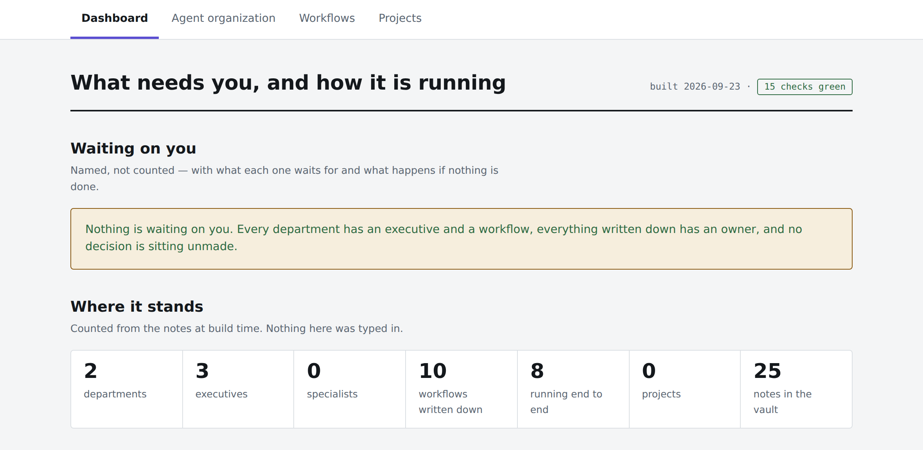
CHECKPOINT
Everyone should be looking at this
Four tabs
Dashboard, agent organization, workflows, projects.
Honest on day one
Two departments, three executives, and it says so. Not your job yet — that is next.
10
Notes:
Do not try to read this from the projector — everyone has it full size on their own screen. Hold the room until hands are down.

Slide 11
HANDS ON · THE REAL FIRST STEP
5
Name your departments
DO THIS NOW
Tell Claude the parts of your job. Three to six, in your own words.
You will know it worked when one note per department appears, each with an executive attached to it.
WHAT COUNTS AS ONE
THREE TO SIX
A part of your job you answer for
Not twelve
The accounts. The reporting. The posting. The thing you inherited that nobody else touches.
If two would never disagree about anything, they are one. You can add another next week in a sentence.
11
Notes:
Give this five minutes and walk the room. The twelve-department instinct is universal; push back. Ask two or three people to say theirs out loud — it unsticks everyone else.

Slide 12
WHAT YOU JUST CREATED
Executives own a department and operate it
Each department note compiles into an agent that answers for that department and nothing else. That is the unit everything else hangs off.
IT ANSWERS
IT PREPARES
IT STOPS
For one department
It does not decide
Somewhere stated
Ask it about its own ground and it knows the notes, the workflows and what is outstanding. Ask it about somebody else's and it hands the question back.
Drafts, assessments, the next version of a note. Publishing, sending, spending and deleting stay yours — that never changes.
Every executive writes down what it does not own. An agent always answers; the stop line is what makes the answers you do get worth having.
Add a department next month and you get another one — same sentence, no setup.
12
Notes:
The third card is the one people remember in a fortnight. Give a real example: a question you would not want an assistant guessing at.

Slide 13
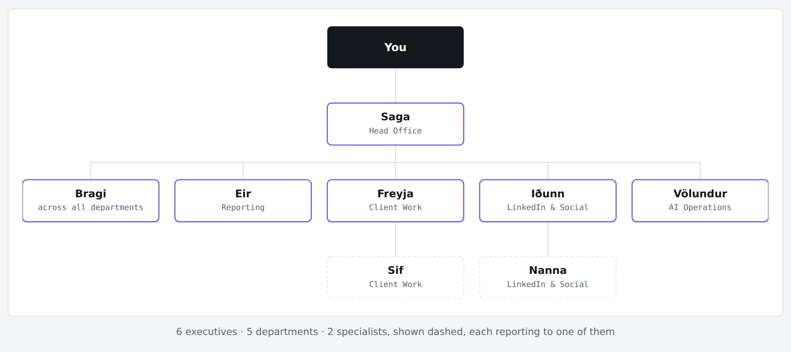
YOUR ORGANISATION
That is an executive layer, and it is yours
Nobody drew this. It is read off each role note — who it reports to, which department it answers for — and redrawn every time the site is built.
13
Notes:
These names came from the Norse option at install — theirs will differ. Point at the dashed boxes: those are specialists, which is the next two steps. Point at Bragi, across all departments: it owns how a workflow gets written down, not what any department does.

Slide 14
HANDS ON
6
Teach an executive a skill
DO THIS NOW
Pick something you explain the same way every time. Say: teach [executive] a skill for this, and then describe how you do it.
You will know it worked when a skill appears in your vault, and the executive knows to reach for it by name.
WHAT A SKILL IS
HOW YOU KNOW YOU NEED ONE
Your method, written once
You explained it twice
When to use it, the steps, where it stops. It is why the agent works your way instead of improvising.
The second time you type the same guidance, it should have been a skill the first time.
14
Notes:
Ask for examples from the room before they type — most people have three of these and have never written one down. Good ones: how you qualify an enquiry, how you structure an update, what makes a good handover.

Slide 15
HANDS ON · THE LAST ONE
7
Give an executive a specialist
DO THIS NOW
Say: add a specialist under [executive] that does [one narrow job]. Then rebuild and look at the chart.
You will know it worked when a dashed box appears under that executive — its own agent, with one job.
NARROW ON PURPOSE
THE TEST
One job, done properly
A task, not an area
Spots quiet accounts. Drafts the post. Writes the first pass. Anything else, it hands straight back.
Several kinds of work? That is a department. One fiddly thing that keeps going wrong? That is this.
15
Notes:
Specialists are where this starts feeling like a team rather than a chatbot. Keep them narrow in the room — the instinct is to make one specialist that does everything, which is just the executive again.

Slide 16
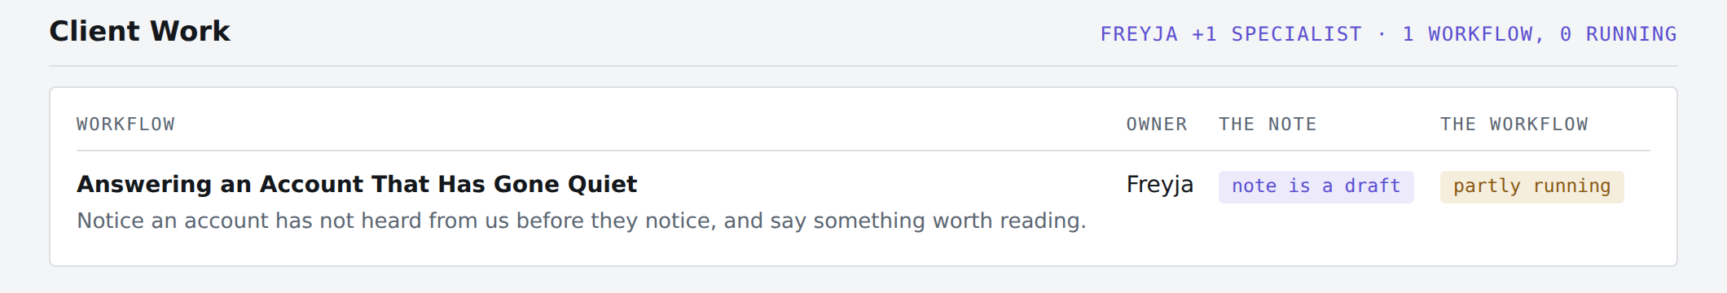
WHAT THE LAYER PRODUCES
Workflows and projects belong to a department
A workflow is how a piece of work happens. A project is a piece of work with an end. Both belong to a department, so neither drifts into a pile nobody owns.
TWO MARKS, NOT ONE
THE NUMBER TO LOOK AT
Written down is not working
One workflow, none running
Is the note true? Only after one real case. Does it run end to end? Different question.
Uncomfortable, true, and you did not have to admit it. It was counted.
16
Notes:
Point at the zero. Counted rather than reported, so it cannot be quietly optimistic. Ask how many of their own written processes would survive that column.

Slide 17
AN HOUR AGO THIS WAS AN EMPTY FOLDER
Look at what is on your laptop
A vault
Departments
Executives
plain text, yours
the parts of your job
one answering for each
A specialist
A skill
A dashboard
one job, done properly
your method, written once
counted, never typed
None of it needs us. None of it phones home. It all still opens if you never speak to an AI again.
17
Notes:
Slow down here. Read the six out loud. An hour ago every one of these was a thing they would have said needed an IT project.

Slide 18
FROM HERE
The next one is just more of the same
You have now made one of everything. Nothing you add after today is a new kind of thing to learn.
—
Another department
The moment you notice a part of your job nobody answers for.
—
Another specialist
The second time one job goes wrong the same way.
—
Another skill
The second time you explain the same thing.
—
A schedule
When you want the week closed on Friday without being asked.
Monday: open the project, not a new chat. That is the whole habit.
Notes:
Send them away with one instruction, not four: open the project instead of a new chat. Everything else is downstream of that habit. Then offer to come back in a month and look at what they built.

